Slide 1
Support Team Meeting
Billing/Invoice Tips

Slide 2
Goals of Training
Understand commonly used insurance terms
Understand some of the variables surrounding insurance reimbursement
Feel comfortable running an insurance verification and/or having a conversation regarding benefit coverage (front desk)

Slide 3
Question: Where does the billing process start?
Answer: The first conversation with a patient! Setting proper expectations is critical

Slide 4
Background – Billing Processes
Insurance companies offer benefits to their beneficiaries/members based on the plan a beneficiary/member chooses at time of enrollment.
Full Range simply processes claims based on their benefits
So where does our responsibly start/end:
Maintaining our education on commonly used insurance terms and insurance policies as they relate to our services
Educating the client on their plan as it related to our services.
We are responsible to the Insurance Company to uphold their insurance benefit details with response to the services we provide to their members. This includes timely submission of claims and timely mailing of patient invoices should the be needed.

Slide 5
Background – Billing Processes (Continued)
Our goal is to provide excellent customer service.
The key to this is patience, humility, honesty and individual education.
A client's bill is based on the patient's insurance… not Full Range’s billing practices.
Often just listing to the patient, educating them on their insurance benefits and the reasons for any potential balance is all they want.

Slide 6
Important Commonly User Insurance Terms

Slide 7
Insurance Term - Deductible
Description of Term
Refers to a fixed amount the member is responsible for paying before the insurance company begins to contribute towards services. This is typically an annual total that is pegged to the calendar year. Some plans may alter from the annual cycle
Teachers Unions for example are often July 1 to June 30.
Example
A patient with an $800 deductible will pay the first $800 of associated charged before the insurance plan starts contributing.
This includes the sum of all healthcare claims during associated time period.

Slide 8
Insurance Term – Copayment “Copay”
Description of Term
Refers to a fixed amount set by an insurance company that a patient would pay on each date of service. However, if a plan has a deductible, the deductible must first be met.
Common copay’s may be: $15, $25, or $30.
Example
A with a $15 copay will be responsible for $15 at time of each visit.

Slide 9
Insurance Term – Co-Insurance
Description of Term
Refers to a percentage of cost for which a patient is responsible. This is an arrangement with the insurance company to share payment for health care services. This is after a deductible is met.
A common co-insurance split is 90/10 in which 90% is covered by the insurance plan
Example
A patient that has a 10% co-insurance would pay $10 on a service that costs $100.

Slide 10
Insurance Term – Out-of-Pocket Maximums
Description of Term
Refers to the highest amount a patient is responsible for during the benefit cycle.
The insurance plan/company will pay 100% after this is met.
Most insurance plans set up a yearly out-of-pocket maximum
Example
If a patient has an out-of-pocket maximum of $5,000, the insurance plan will pay 100% of expenses once the patient contributes $5,000 towards qualifying payments (deductible, co-insurance, co-pay).

Slide 11
Workshop – How much do you remember?!
Deductible
Co-Pay
Co-Insurance
Out-of-Pocket Maximums

Slide 12
Workshop – Let’s give this a shot!
Staff member leading training will pull most recent 2-3 referrals to verify insurance benefits together!
Include Payors:
Medicare
Independence Blue Cross
Aetna *note: Full Range is considered out-of-network with Aetna

Slide 13
Locating a Specific Invoice in current EMR (S4PT)

Slide 14
Steps
It’s helpful to see exactly what the patient is looking at.
Follow the below steps to locate a copy of their invoice.
Information needed: Patients Last Name
Corporate Reports
New Invoices – search by Last Name
or
New Invoices
To locate a specific Invoice
Invoice History
Invoice Batch History
Individual Batch

Slide 15
Step 1 –Click “Corporate Reports”

Slide 16
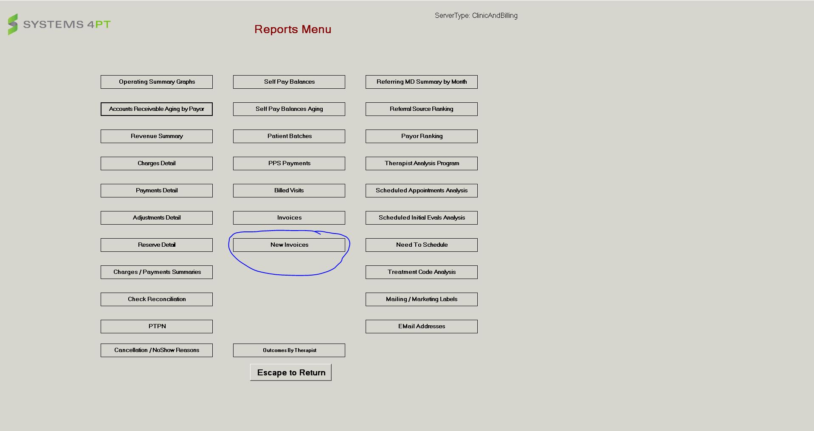
Step 2 – Click “New Invoices”

Slide 17
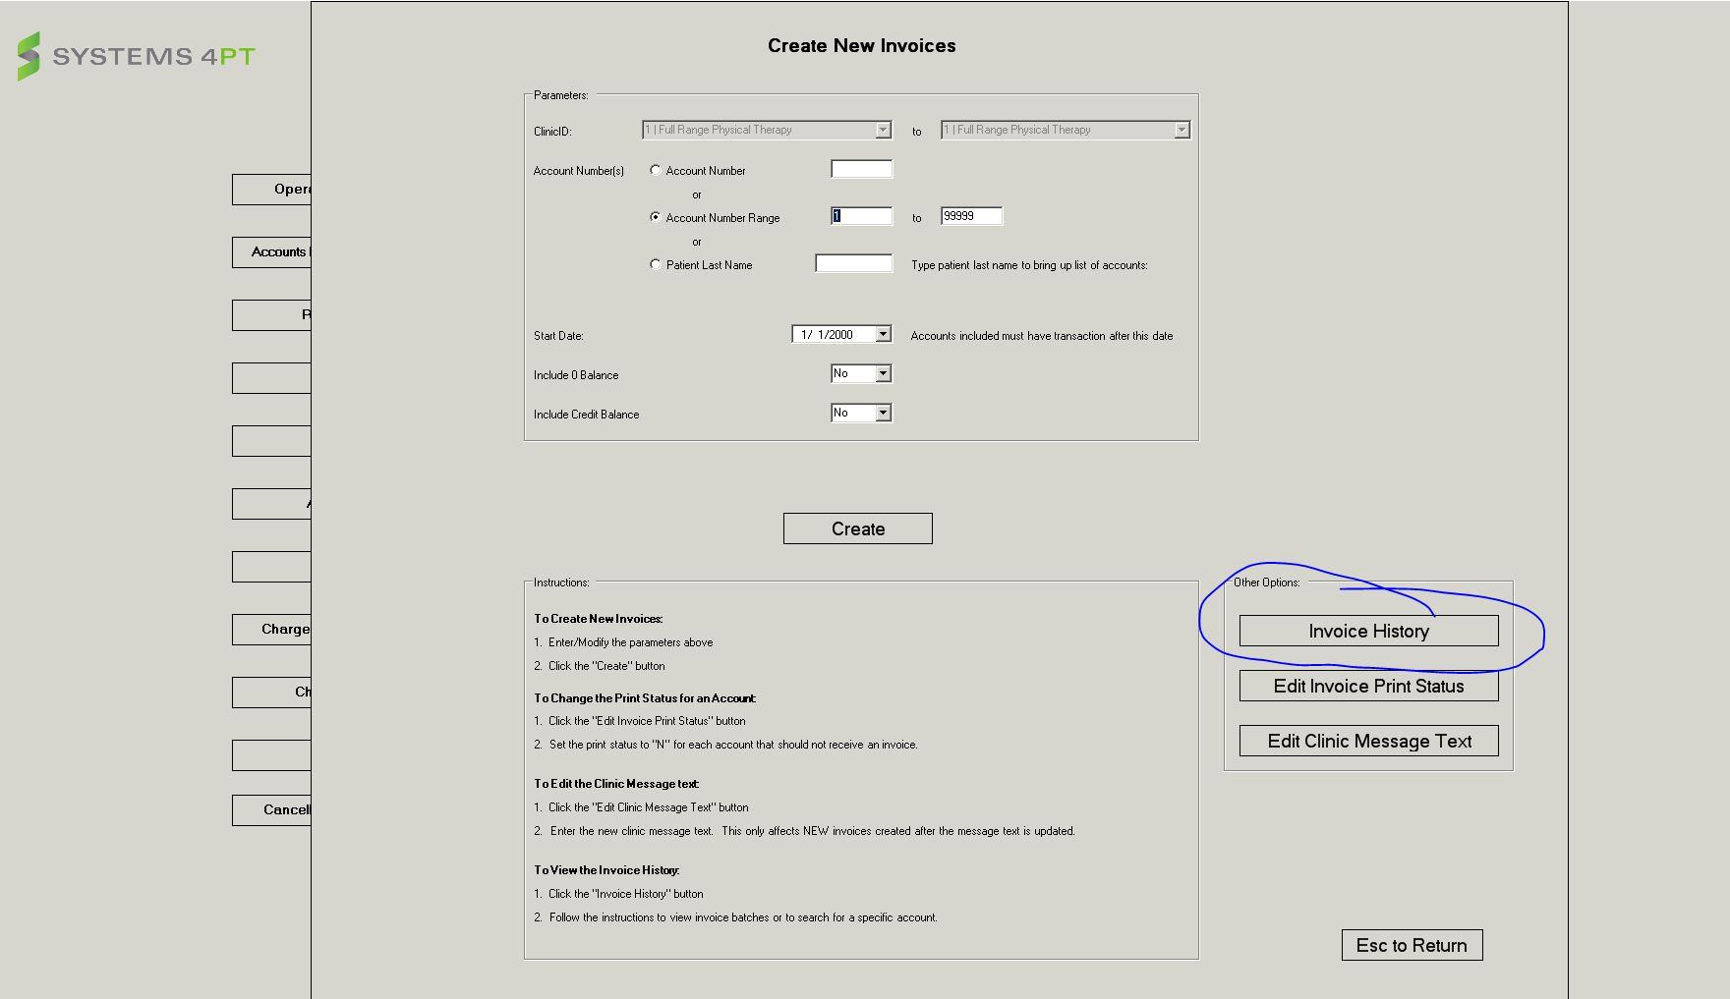
Step 3 – Select “Invoice History”

Slide 18
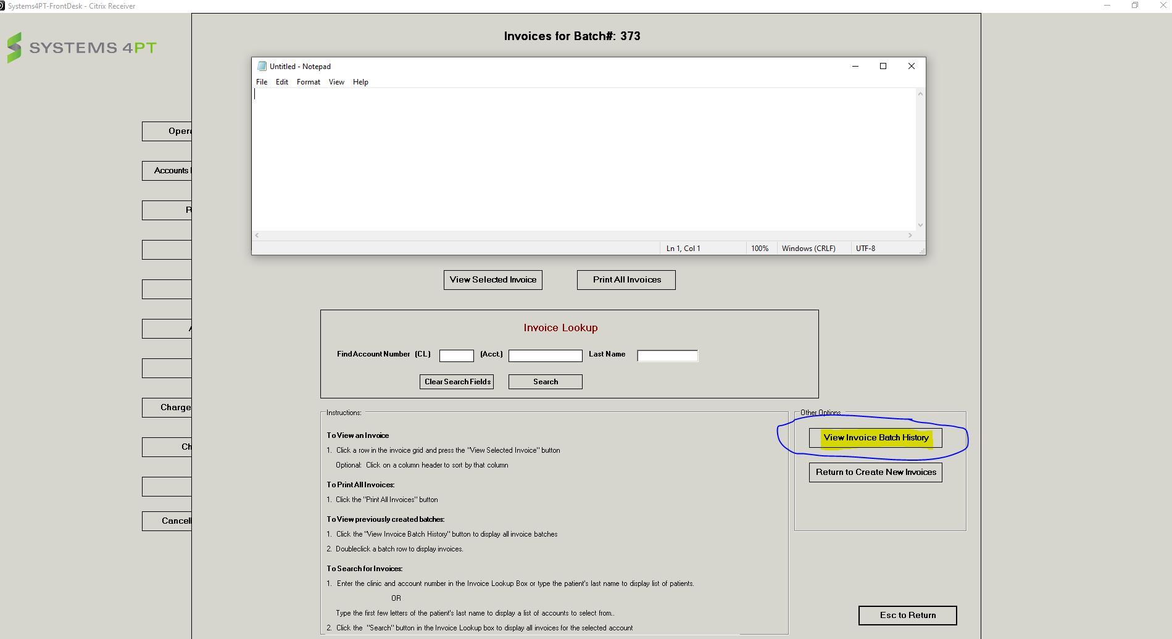
Step 4 Select “View Invoice Batch History”

Slide 19
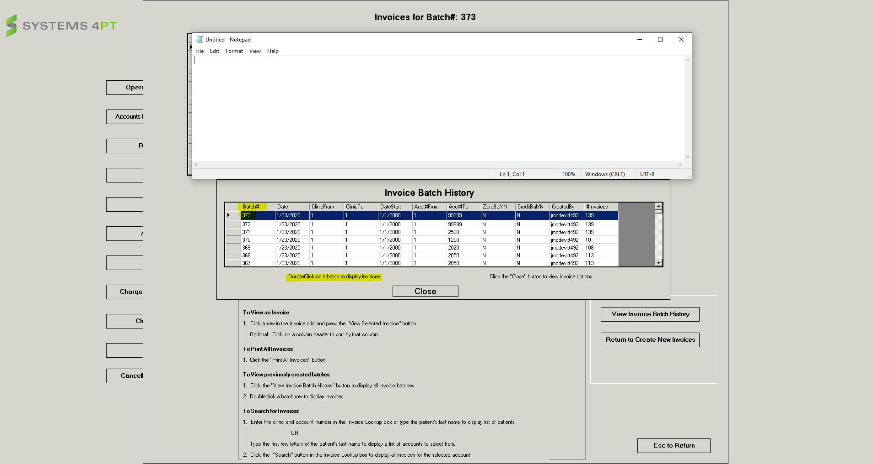
Step 5

Slide 20
Steps
After locating Batch
“Close” the batch options
Scroll to locate patients' invoice
Click “View Selected Invoice”
Identify on patient invoice what the reason for patient responsibility under “Description”
Patient Copay
Deductible Not Met
Coinsurance
This will help steer the conversation

Slide 21
Additional Details – EMR – Current and Past Patients

Slide 22
Additional Area for Review (Optional)
FOCUS Menu
Patient Account Detail
Breaks down each DOS by insurance payer and lists what the insurance company paid and the reason code for why the insurance company transferred a portion of the balance to the patient.
Also Identifies any DOS still outstanding

Slide 23
Regulation Considerations

Slide 24
Fun Info!
Timely Filing to Insurance– 365 Days
Average turnaround time for a claim – 17- 45days
Claim is submitted electronically daily – only once a patient is checked in and the note is signed by therapist
Writing off bad debt/ uncollected claims
Often healthcare organizations may send a client to collections for unpaid balances –
Can only write off “bad debt” or “uncollected claims” legally once we mail an invoice

